Slide 1

Recursive Function
Recursive

Slide 2
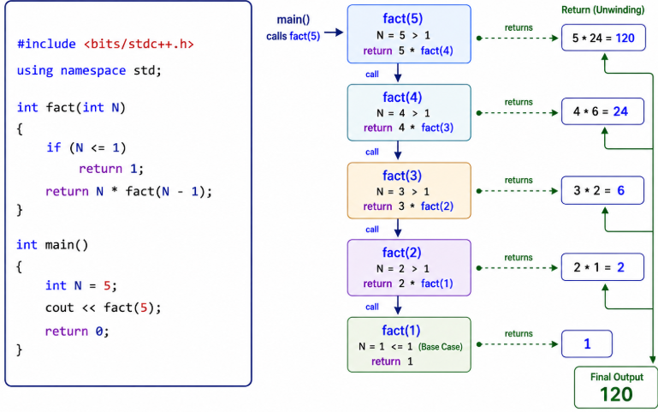

Slide 3
